Slide 1


Talking about emotions in Czech
Laura A. Janda, UiT
Dominika Kováříková,
Charles University

Slide 2
Overview
Psychology of emotions:
Distribution via valence and activation
Linguistic profiles:
Constructional profiles: Russian ‘happiness’ and ‘sadness’
Grammatical profiles of Russian nouns
GramatiKat:
Resource for grammatical profiles
Distribution of Czech emotion nouns:
Synonyms and disparate emotions
Metaphorical implications of case
Case study of ANGER
Conclusions and future plans

Slide 3
Preview of findings
Psychology vs. grammar:
semantic similarity vs. metaphorical substances, agents, locations, etc.
loss of agency, bodily manifestation, regulation
Implications for lexicography:
typical grammatical constructions
structure of semantic fields
applicable to other fields such as color, body parts, time, evaluation, size, quantity, modality, or verbs of motion, speaking and thinking
Implications for pedagogy

Slide 4
Psychology of emotions

Slide 5
Two approaches in psychology
An ongoing controversy…
Each emotion is a discrete vector (Eckman 1992, Keltner & Oatley 2022)
No coherence as a semantic field ≈ a null hypothesis
A minority opinion
“Circumplex” distribution (Ross 1938, Russell 1980, Aydede 2018, Brackett 2019)
based on sorting and classification tasks
two dimensions:
“valence” (x-axis) = positive vs. negative
“activation” (y-axis) = low vs. high intensity

Slide 6
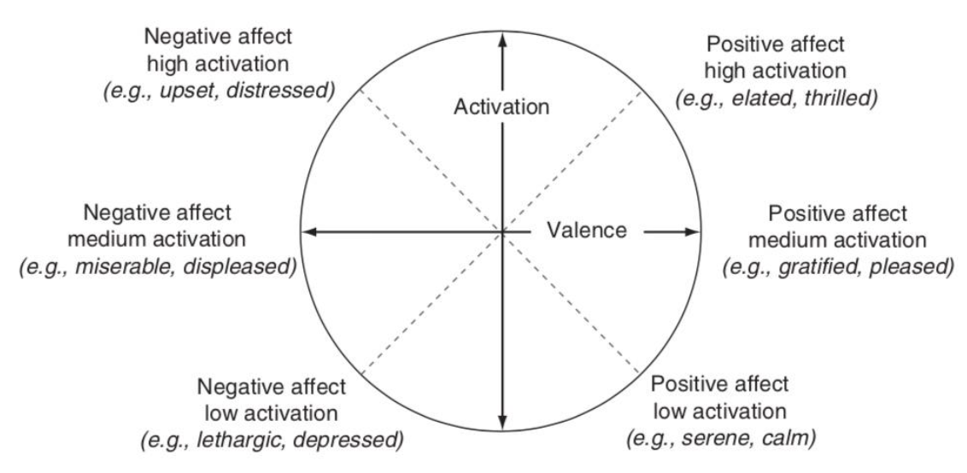
The affective circumplex according to many psychologists

Slide 7
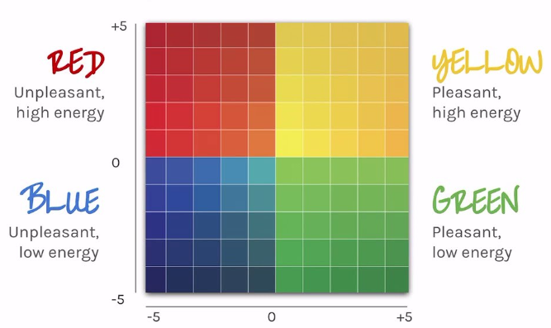
Brackett’s (2019) “mood meter”

Slide 8
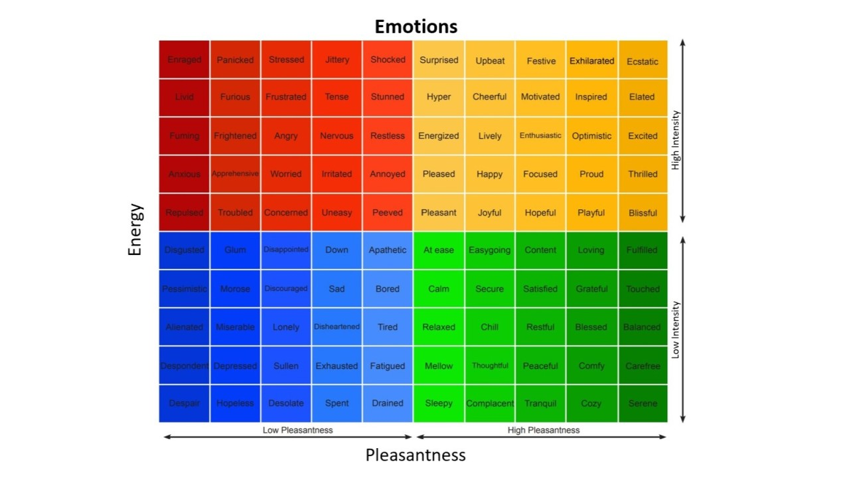
[adjectives]

Slide 9
Linguistic profiles

Slide 10
Constructional profiles : Russian ‘happiness’ and ‘sadness’ (Janda & Solovyev 2009)
Constructional profile = “the distribution of relative frequencies of constructions associated with a given word”
≈ 70 constructions of the form “[(preposition) [noun]_{case}]” in Russian
But only about 6 (or fewer) constructions are needed to characterize a given noun (cf. similar findings by Karlsson 1985, 1986 and Arppe 2001, 2005)
Data from Russian National Corpus (http://www.ruscorpora.ru) >120M words and Biblioteka Maksima Moškova (http://lib.ru/) >600M words
500 sentences each extracted and manually coded for use of preposition & case, hierarchical cluster analysis
Example of constructional profile of восторг ‘ecstasy’

Slide 11
‘into’
‘in’
‘agent’
‘with’
‘from’

Slide 12

‘Sadness’ in Russian
грусть, меланхолия, печаль, тоска, уныние, хандра
The constructions they appear in:
в + Acc ‘into’
в + Loc ‘in’
Inst: Agent
s + Inst ‘with’
от + Gen ‘from’
(Direct Object)
(Other Constructions)
Graphs will show only these five,
as percentages
Hierarchical Cluster Analysis
is computed from all data

Slide 13
The ‘sadness’ nouns
They can’t all be the same:
Уходишь, и я гляжу вслед тебе с грустью, но без тоски.
‘You leave and I watch you go with sadness_{грусть}, but without sadness_{тоскa}.’
Dictionaries differ on how synonyms are grouped

Slide 14
‘Sadness’
Hierarchical Cluster
печаль
тоска
хандра
меланхолия
грусть
уныние

Slide 18

‘Happiness’ in Russian
ликование, наслаждение, радость, счастие, удовольствие, вострог
Antonyms are words that are virtually identical, but differ in one value
‘Happiness’ nouns focus on the same constructions in their constructional profiles as ‘sadness’ nouns
Dictionaries differ widely in grouping of ‘happiness’ synonyms

Slide 19
‘Happiness’
Hierarchical Cluster
наслаждение
радость
удовольствие
ликование
счастие
восторг

Slide 22
About the results...
The results are statistically significant
For ‘sadness’ nouns: chi square = 730.35, and Cramer’s V = 0.305 which qualifies as a moderate effect (p<0.0001, df=30)
For ‘happiness’ nouns: chi square = 774.6, Cramer’s V = 0.268 which qualifies as a moderate effect (p<0.0001, df=30)

Slide 23
The part that didn’t get published: Metaphor
Constructional profiles reveal that emotions such as happiness and sadness in Russian are understood as
metaphorical holes or mires
metaphorical agents
metaphorical accessories (gestures)
metaphorical diseases
metaphorical sources

Slide 24
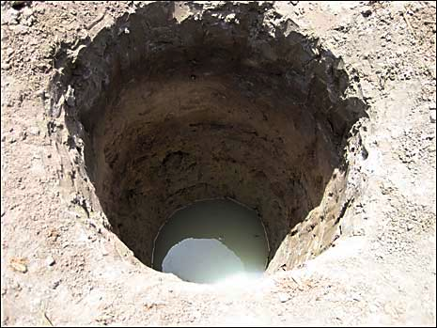
в + Acc ‘into’
Я же живой человек и, конечно, иногда впадаю в уныние.
‘I am a living person, and, of course, occasionally fall into sadness.’

Slide 25
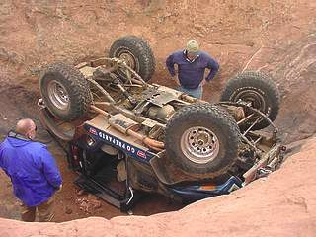
в + Loc ‘in’
Ей на ум не придет, что супруг изнывает в тоске о потерянных минутах труда и вдохновения.
‘It doesn’t occur to her that her spouse is suffering in sadness over the minutes of work and inspiration that he has lost.’
BUT: You don’t crawl out! из + Gen is exceedingly rare

Slide 26

Inst: Agent
Кто из живущих, томимый унынием, не предавался такому перебору не состоявшихся жизненных вариантов?
‘Who among mortals tormented by sadness, has not indulged in an inventory of all the things that didn’t happen in their life?’

Slide 27
с + Inst ‘with’ (a gesture like a smile)
-Кушаешь ты, как свинья, - с грустью сказал капитан.
‘--You eat like a pig’-- said the captain with sadness.’

Slide 28
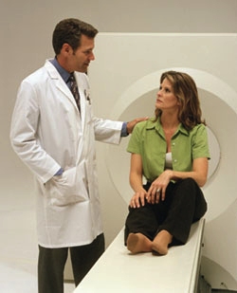
от + Gen ‘from’: Healing from disease
Самое лучшее лекарство от хандры – это чтение.
‘The best cure for sadness is reading.’

Slide 29
от + Gen ‘from’: Cause/Source
Подумайте, этот человек умер от меланхолии!
‘Just imagine, that person died of sadness!’

Slide 30
Grammatical profiles of Russian nouns (Janda & Tyers 2021)
Grammatical profile = “the distribution of relative frequencies of inflected forms associated with a given word”
Zipf’s law affects distribution of inflected forms
<10% of wordforms are frequent, others rare or unencountered
Each lexeme is common in a subset of wordforms
Wordforms common to a lexeme are motivated by typical collocations and grammatical constructions

Slide 31
Examples of high-frequency Russian nouns
‘fear’ ‘soldier’ ‘department’ ‘concept’ ‘memory’
Nsg | страх | солдат | отделение | концепция | память
Gsg | страха | солдата | отделения | концепции | памяти
Dsg | страху | солдату | отделению | концепции | памяти
Asg | страх | солдата | отделение | концепцию | память
Isg | страхом | солдатом | отделением | концепцией | памятью
Lsg | страхе |  | отделении | концепции | памяти
Npl | страхи | солдаты | отделения
Gpl | страхов | солдат | отделений | концепций
Dpl |  | солдатам
Apl | страхи | солдат | отделения | концепции
Ipl | страхами |  | отделениями | концепциями
Lpl | страхах | солдатах | отделениях
Key: bold >20%, plain >10%, grey 1-9%, (blank) unattested

Slide 32
Masculine animates

Slide 33
Typically a lexeme is found in only 1-3 wordforms
Masculine animates

Slide 34
Any single lexeme gives exposure to only a subset of the paradigm.
Each lexeme has a different subset of most typical forms.
Collectively they populate the entire “space” of case/number combinations.
Masculine animates

Slide 35
GramatiKat

Slide 36

https://korpus.cz/gramatikat/
Proof-of-concept for grammatical profiling at scale
Based on Czech SYN2015 and SYN2020, two representative reference corpora totaling 200M words
Grammatical profiles for all lemmas attested 100 or more times in the composite corpus belonging to the three major parts of speech: nouns, verbs, and adjectives.
Whereas the frequencies of inflected forms are in principle available in digital corpora, baseline grammatical profiles for an entire lexicon are “impossible to acquire … from a standard corpus interface such as KonText, AntConc, or SketchEngine, at least not without enormous effort” (Kováříková et al. 2023).

Slide 37
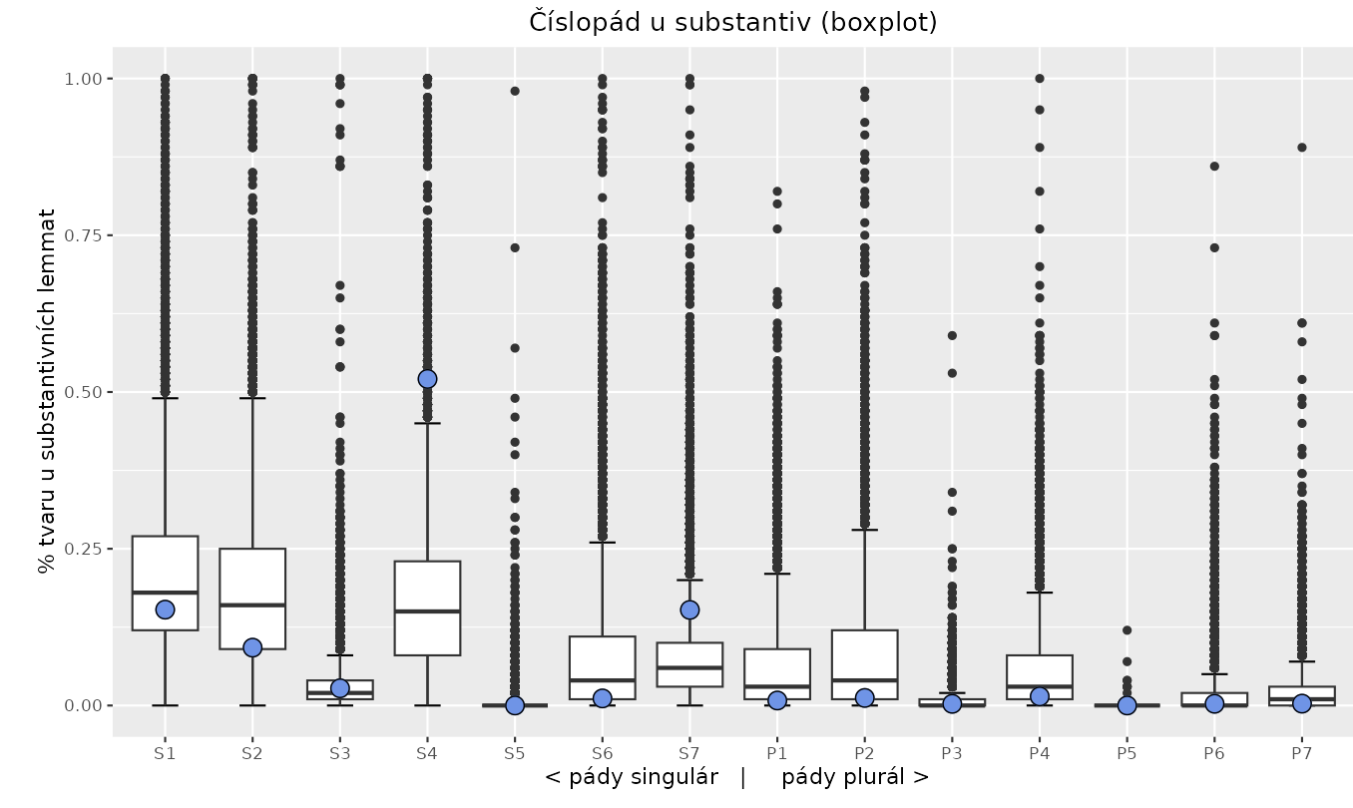
Grammatical profile of radost ‘joy’ (blue dots) vs. nouns attested ≥ 100 in SYNv11 corpus
Case:
“backbone” of grammatical constructions
always obligatory
marks relationships to prepositions, verbs, other NPs
Cases: 1 = Nominative, 2 = Genitive, 3 = Dative,
4 = Accusative, 5 = Vocative, 6 = Locative, 7 = Instrumental

Slide 38
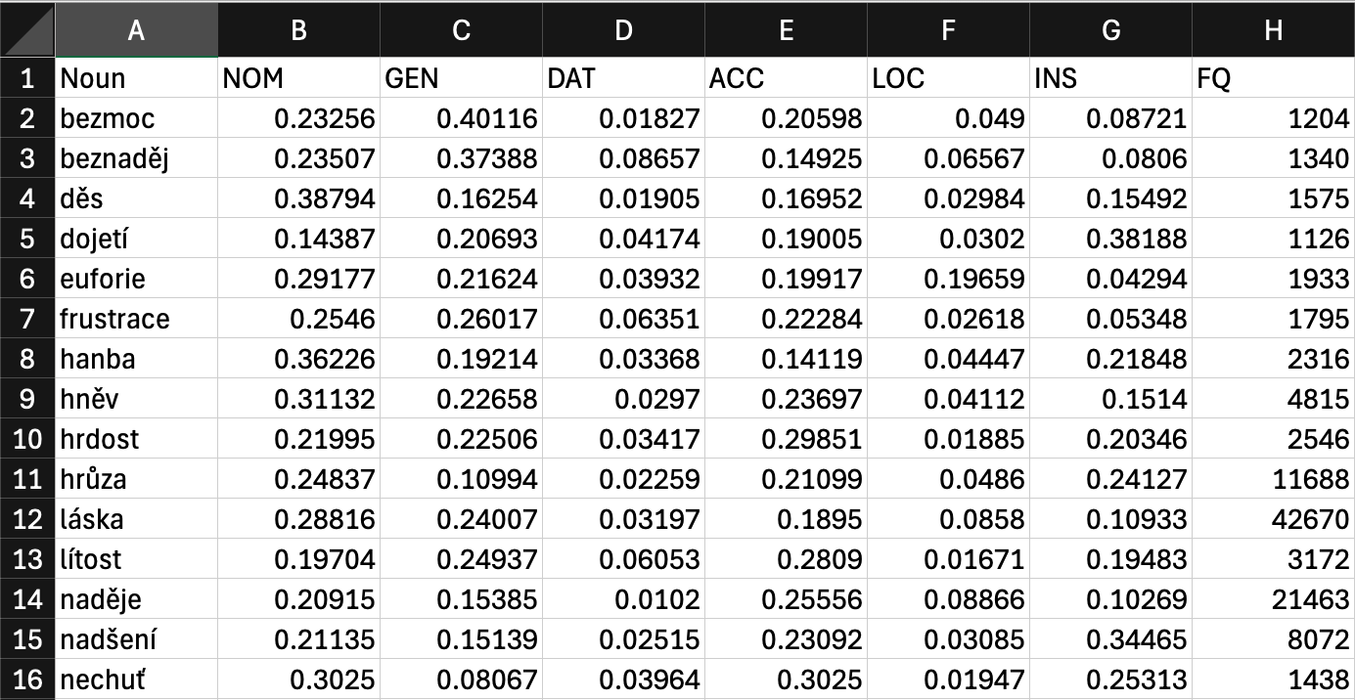
Grammatical profiles of 65 emotion nouns
This is the input data (relative frequencies) for correspondence analysis

Slide 39
Distribution of Czech emotion nouns

Slide 40
4 “deviant” emotions
rozpaky ‘embarrassment’: rarely used in NOM
tíseň ‘distress’: extreme outlier in LOC (= “container”)
údiv ‘astonishment’: outlier in INS and DAT, rarely used in NOM
úžas ‘amazement’: outlier in INS and DAT, rarely used in NOM
These 4 nouns removed to improve visualization on next slides, but included in analysis.

Slide 41
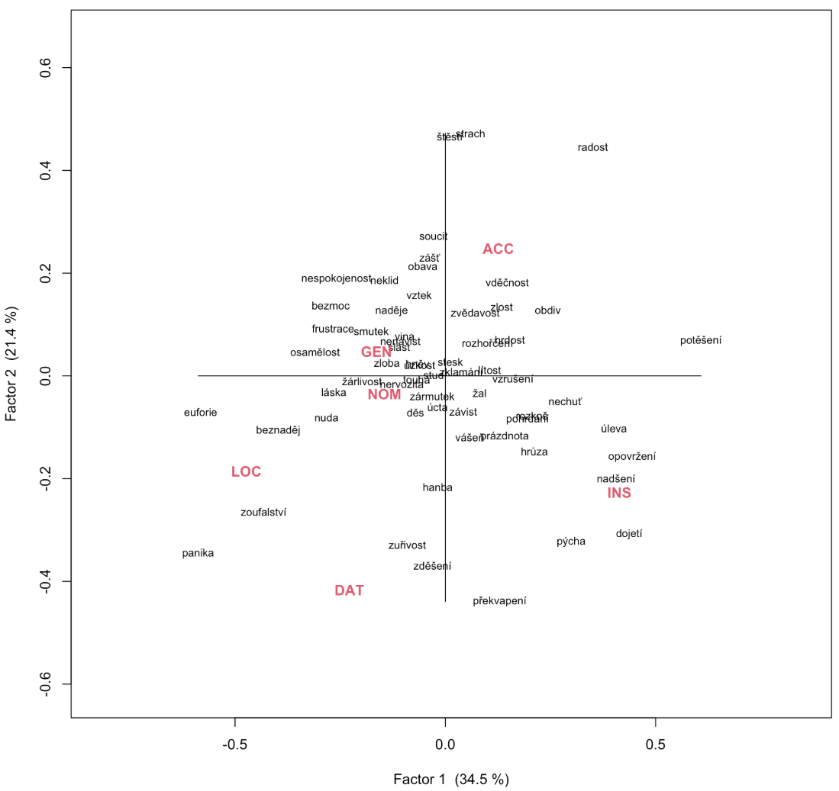
Correspondence analysis of grammatical profiles of
61 Czech
emotion nouns

Slide 42
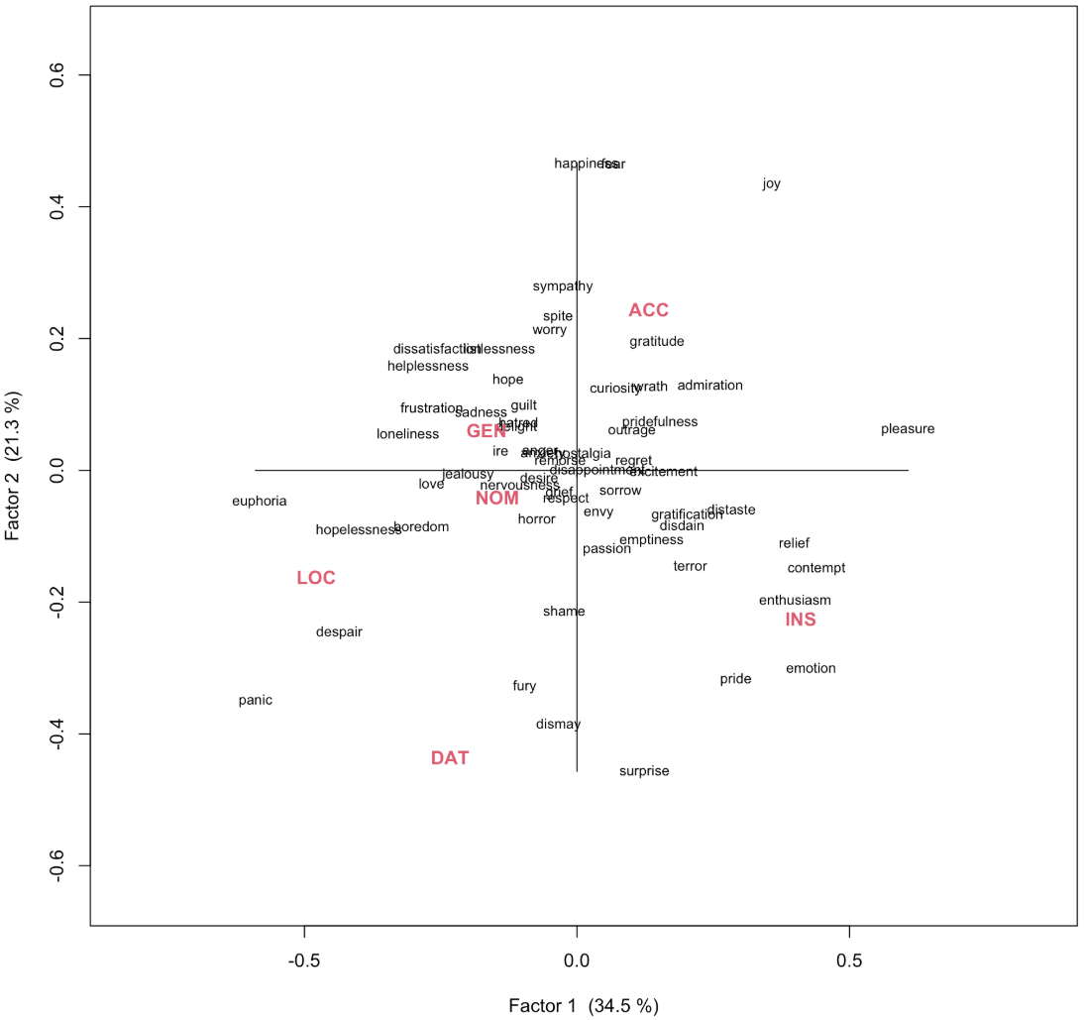
Correspondence analysis
with English glosses

Slide 43
Words with similar meanings behave differently
‘HAPPINESS’
radost
nadšení
euforie
potěšení
úleva
rozkoš
štěstí
slast

Slide 44
Words with very different meanings that behave similarly:
štěstí ‘happiness‘ + strach ‘fear‘
slast ‘delight’ +
smutek ‘sadness’

Slide 45
Metaphorical implications of case

Slide 46
ACC: metaphorical
possessions
GEN: metaphorical
substances, sources
Metaphorical implications of case usage and constructions
NOM: metaphorical
agents
NOTE:
In following slides “E” stands for an emotion noun
INS: metaphorical forces, accessories
LOC: metaphorical
containers
DAT: metaphorical
attractors

Slide 47
Nominative case
E-NOM VP (verbs: zmocnit ‘take control of’, zachvátit ‘grab’, narůstat ‘grow’)
E is an agent, a living thing
E = nervozita ‘nervousness’, děs ‘horror’, hanba ‘shame’, neklid ‘listlessness’, panika ‘panic’
Stála jsem na silnici půl hodiny a moje nervozita narůstala.
‘I was standing on the road for a half hour and my nervousness was growing.’

Slide 48
Genitive case - 1
plný E-GEN ‘full of E’
E is a substance in a person or body parts
E = almost any emotion, especially naděje ‘hope‘, překvapení ‘surprise‘, nenávist ‘hatred‘, láska ‘love’
Muž se narovnal a ohlédl se na svou ženu, která na něj hleděla očima plnýma naděje a úžasu. ‘Her husband straightened up and glanced at his wife who was looking at him with eyes full of hope and amazement.’
NP E-GEN ‘NP (consisting) of E’
E is a substance measured by a pseudo-quantifier
E = most emotions
Zaplavila ho vlna touhy ‘A wave of desire washed over him.’

Slide 49
Genitive case - 2
(VP) z E-GEN ‘(VP) from/because of E’
E is a source/cause (cf. E z NP-GEN ‘E from/because of NP’)
E = vděčnost ‘gratitude’, láska ‘love’, obavy ‘worries’
Z vděčnosti ho Viktorie políbila na vousatou tvář. ‘From gratitude Viktorie kissed him on his bearded cheek.’
bez E-GEN ‘without E’
E is something that can be absent (cf. s E-INS ‘with E’)
E = láska ‘love‘, lítost ‘regret‘, naděje ‘hope‘
Rodnou zemi opouštěli bez lítosti. ‘They abandoned their homeland without regret.’

Slide 50
Dative case
NP VP E-DAT (verbs: propadnout ‘succumb to’, podlehnout ‘succumb to’)
E is a powerful force
E = panika ‘panic’, zoufalství ‘despair’, beznaděj ‘hopelessness’
Další naděje zhasla a já znovu propadla zoufalství. ’Further hope was extinguished and once again I succumbed to despair.’
NP být k E-DAT ’be the cause of E’ /XP k E-DAT ‘cause E’ (dohánět ‘catch up to‘, přivádět ‘lead to‘, důvod (‘cause‘)
E is an attractor
E = zděšení ‘dismay’, překvapení ‘surprise’, zuřivost ‘fury’
K zděšení mých druhů jsem se začal smát. ’To the dismay of my companions, I started to laugh.’

Slide 51
Accusative case - 1
mít E-ACC ’have E’ (experience E) (cf. můj, tvůj E ’my, your E’)
E is a possession
E = radost ‘joy’, strach ‘fear’, štěstí ‘happiness’, potěšení ‘pleasure’, zlost ‘indignation’
Myslela jsem, že budeš mít radost ‘I thought you would be happy’

Slide 52
Accusative case - 2
NP V E-ACC (verbs: vyvolat ‘provoke’, vzbudit ‘awaken’)
E is a creature or force that can be aroused
E = obavy ‘worries’, údiv ‘astonishment’, vášeň ‘passion’, nadšení ’enthusiasm’
Jeho komentář vyvolal údiv ‘His comment provoked astonishment’
NP V E-ACC (verbs: potlačit ‘suppress’, skrýt ‘hide’)
E can be suppressed, hidden
E = hněv ’anger’, zklamání ‘disappointment’, překvapení ‘surprise’, opovržení ‘contempt’
Lloyd potlačil hněv, který v něm okamžitě vzplanul. ‘Lloyd suppressed the anger that immediately flared up inside him.’
Isabella se ani nesnažila skrýt zklamání. ‘Isabella didn’t even try to hide [her] disappointment.’

Slide 53
Locative case
VP v E-LOC ‘VP in E’
E is a substance or container that envelops (cf. hluboký E ’deep E’)
E = zoufalství ‘despair’, panika ‘panic’, beznaděj ‘hopelessness’
Odvrátila obličej a v zoufalství zavřela oči. ‘She turned her face away and in despair closed her eyes.’
V panice se naklonila přes most a uvažovala, jestli by nebylo lepší vrhnout se dolů. ‘In a panic she leaned over the bridge and wondered whether it wouldn’t be better to throw herself down.’

Slide 54
Instrumental case - 1
VP s E-INS ‘with E’
E is an accessory or gesture
E = dojetí ‘emotion’, hrůza ‘terror’, nadšení ‘enthusiasm’, opovržení ‘contempt’, úleva ‘relief’
Kassandra jí s úlevou pohlédla do tváře ‘Kassandra looked her in the face with relief’

Slide 55
Instrumental case - 2
VP E-INS ‘VP due to E’ (verbs plakat ‘weep’, brečet ‘cry’, zrudnout ‘blush’, dmout ’puff up’)
E is a force that causes VP
E = dojetí ‘emotion’, pýcha ‘pride’, stud ‘remorse’
Samozřejmě , že by se Charlie dmul pýchou až k prasknutí. ’Of course Charlie would be puffed up to the bursting point with pride.’
naplněný E-INS ‘filled with E’
E is a substance that fills people
E = hrůza ‘terror’, nenávist ‘hatred’, naděje ‘hope’, touha ‘desire’, pýcha ‘pride’
posadila se vedle mne a pozorovala ho vykulenýma očima naplněnýma hrůzou ‘she sat next to me and watched him with bulging eyes filled with terror’

Slide 56
Other common constructions - 1
E v NP-LOC ‘E in one‘s NP‘
(NP: oči ‘eyes’, tvář ‘face’, hlas ‘voice’, slova ‘words’, srdce ‘heart’)
Ale viděl jsem smutek v očích chlapců ‘But I saw the sorrow in the boys’ eyes’
pro E-ACC ‘for E’
Měla by sis koupit něco pro radost. ‘You should buy yourself something to make you happy [for joy].’

Slide 57
Other common constructions - 2
E k / vůči NP-DAT ‘E toward NP‘
Úcta k aristokracii byla v Angličanech hluboce zakořeněná ‘Respect for the aristocracy has deep roots among the English‘
Nepochyboval o tom, že jeho zášť vůči otci slábne ‘He has no doubt that his spite for his father was waning’
E z NP-GEN ‘E from/due to NP‘
Už dávno nemám strach ze smrti ‘It’s been a long time since I have been afraid of dying [Already long ago I don’t have fear from death]’

Slide 58
Some less common constructions
do E-GEN ‘to E‘
Přivádělo by ji do rozpaků, že vám tohle všechno vykládám ‘It would embarrass her [bring her to embarrassment] that I am telling you all this’
E před NP-INS ‘E before/in the face of NP‘
Bratr ve strachu před manželkou našlapoval po špičkách ’Brother in fear of his wife was walking on tiptoe’
E nad NP-INS ‘E above NP‘
zuřil jsem bezmocí nad tím , že nemám možnost se bránit ‘I was furious from helplessness due to the fact that I can’t defend myself’
udržet E-ACC na uzdě-LOC ‘keep E on reins’
Eadulf skřípal zuby, aby udržel na uzdě svůj hněv ‘Eadulf clenched his teeth in order to keep his anger in check [on reins]’

Slide 59
Case study of ANGER

Slide 60
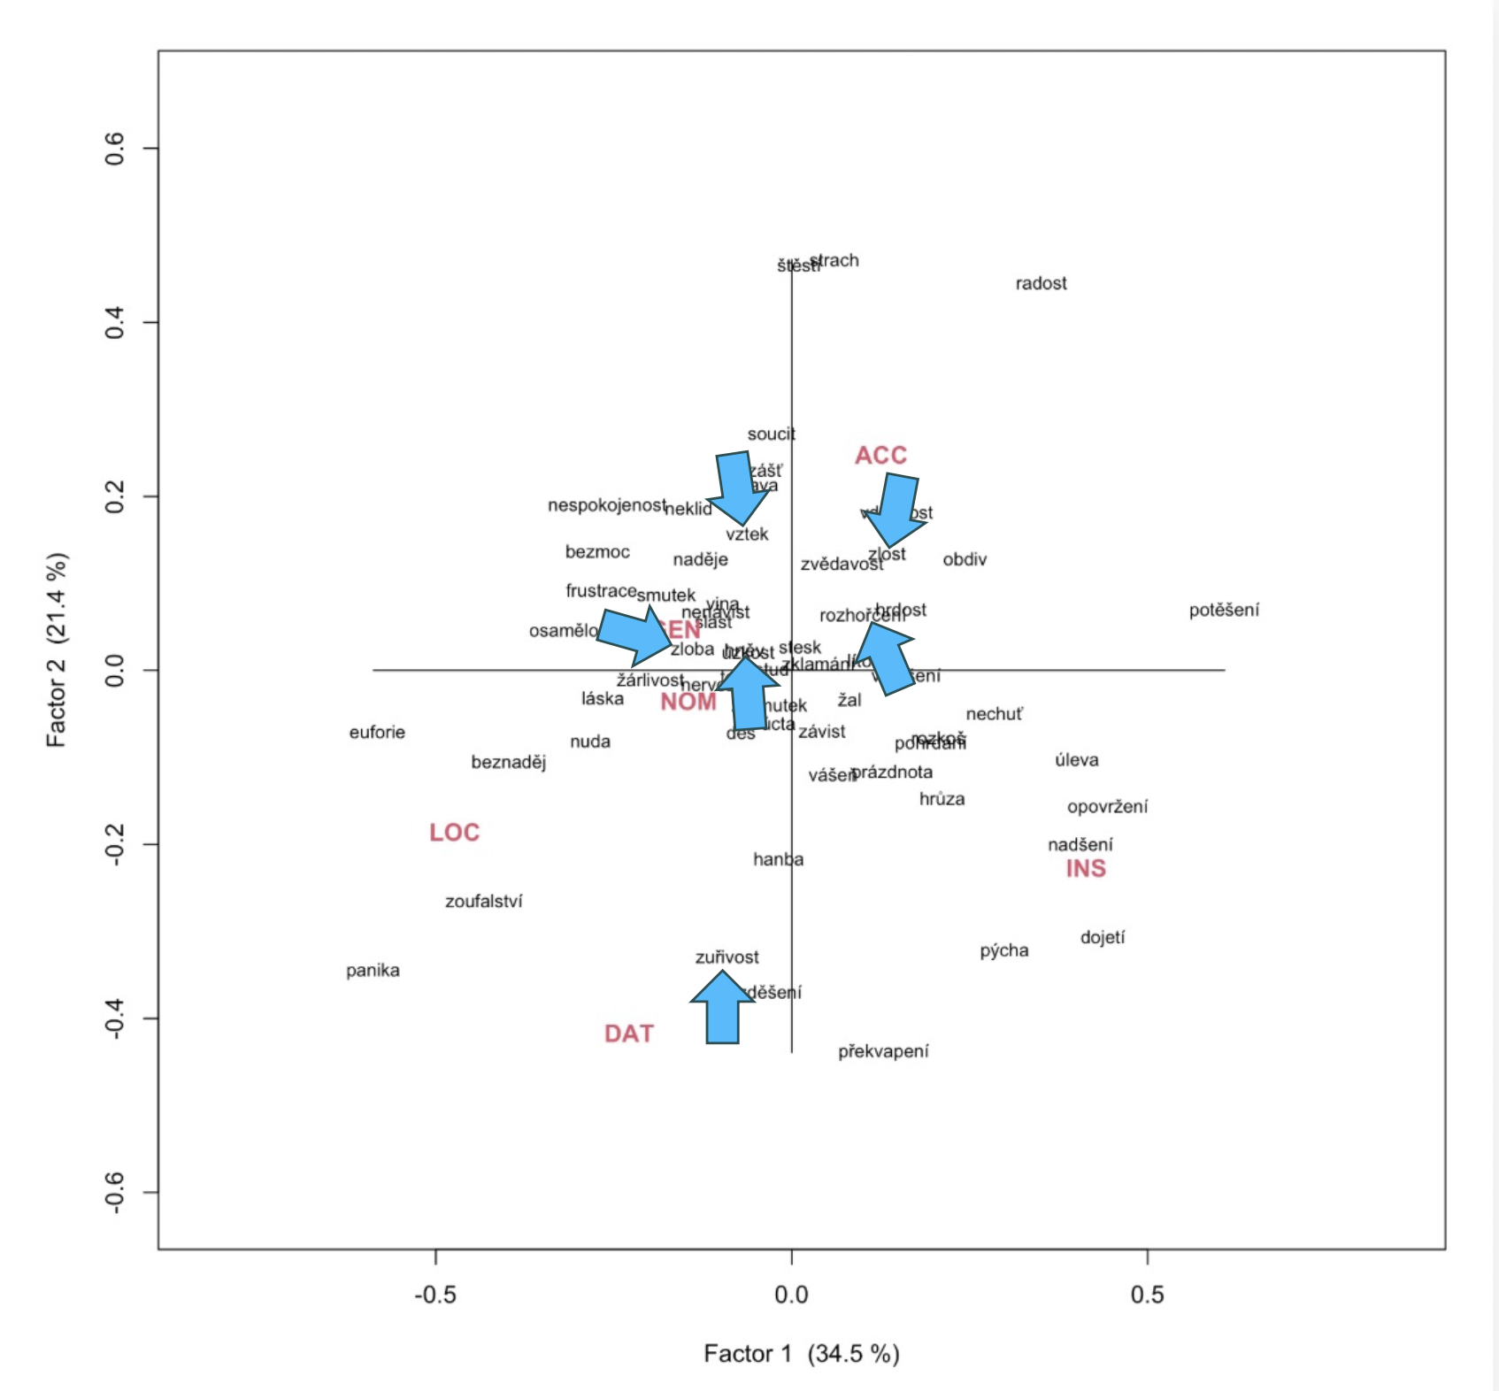
SIX FLAVORS OF ANGER:
hněv ‘anger/wrath’ rozhořčení ‘indignation’ vztek ‘rage/irritation’ zloba ‘malice’ zlost ‘anger’ zuřivost ‘fury’

Slide 61
hněv, zloba: NOM, GEN = agent-like forces or emotional contents
vztek, zlost, rozhořčení: ACC = experienced and controlled states
zuřivost: DAT = state one is driven into

Slide 62
Collocates
Anger as a dynamic and episodic phenomenon that flares up or erupts: vzplanout ‘flare up’, vzkypět ‘boil up’, popadnout ‘seize’, and zachvátit ‘grab’, výbuch ‘explosion’, záchvat ‘fit’, and nával ‘surge’
Other collocates point to bodily manifestation: anger makes people tremble, redden, distort their faces, or show other visible signs of inner tension
Anger often presented as states that need to be controlled, as shown by verbs such as potlačit ‘suppress’, ovládnout ‘take control’, skrývat ‘hide’, and utišit ‘mute’
Anger is typically presented as something that arises suddenly, escalates, becomes visible on the body, and often needs to be controlled

Slide 63
Individual lexemes remain distinct
Vztek ‘rage’ and zlost ‘ire’: ACC, with mít ‘have’, vylít si ‘pour out one’s’, and vybít si ‘work out one’s’ -- anger that is strongly felt and then vented
Zuřivost ‘fury’: DAT, an extreme state that a person is pushed into
Rozhořčení ‘indignation’: publicm evaluative profile, moral judgement: spravedlivé/oprávněné rozhořčení ‘righteous/justified indignation’, vyjádřit rozhořčení ‘express indignation’
Hněv ‘anger’: dynamic processes vzplanout ‘flare up’, vzkypět ‘boil up’, and vyprchat ‘fade away’
Zloba ‘malice’: substance-like material (plný zloby ‘full of malice’)

Slide 64
Conclusions and future plans

Slide 65
Conclusions
Contrary to what psychologists suggest, grammar does not treat emotions along axes of polarity and intensity, instead they behave as metaphorical containers, possessions, forces, substances, etc.
Similar emotions can behave differently, and different emotions can behave similarly
Grammatical constructions reveal various metaphorical roles for emotions: as agents, substances, possessions, forces, containers, etc.
Grammars of different languages can treat emotions differently; learning constructions can help with acquisition of vocabulary

Slide 66
Implications
Lexicography:
Grammatical behaviour is not external to lexical meaning, but part of the lexical profile of the word and part of the way its meaning is realized in use
A semantic field-based description can therefore complement traditional lexicographic practice by showing not only the meanings of individual lexemes, but also their place within a structured network of contrasts and associations
Pedagogy:
Emotion words can be challenging because they are abstract, metaphorical, language-specific
Need to target strategic constructions for learners

Slide 67
Future plans
Book:
Grammar-based analysis of verbs, adjectives, adverbs, prepositions, etc. in expression of emotions in Czech
In Czech, for Czechs
Further applications to other fields such as:
color, body parts, time, evaluation, size, quantity, modality, verbs of motion, speaking and thinking

